Slide 1
Permissions to database objects Indexes RUNSQLSTM Referential Constraint options ON DELETE RESTRICT ON DELETE CASCADE ON DELETE SET DEFAULT Lab 6
DBS201

Slide 2
Permissions to Database Objects
Access for user profiles to Database objects in a collection can be given or taken away
Allow Access in SQL with a GRANT statement
Remove Access in SQL with a REVOKE statement
GRANT or REVOKE are not usable with the collection itself
GRTOBJAUT or EDTOBJAUT are the native commands used for the collection permissions

Slide 3
GRANT
GRANT INSERT, SELECT, UPDATE ON CUSTOMER TO DB201B43, DB201B41
What does that mean?
GRANT SELECT, DELETE, INDEX ON CUSTOMER TO DB201B44, DB201A45
What does that mean?

Slide 4
Taking Away Access
DB201B43 can read, add and change rows with the CUSTOMER TABLE
Take those permissions away?
REVOKE SELECT, INSERT, UPDATE ON CUSTOMER FROM DB201B43

Slide 5
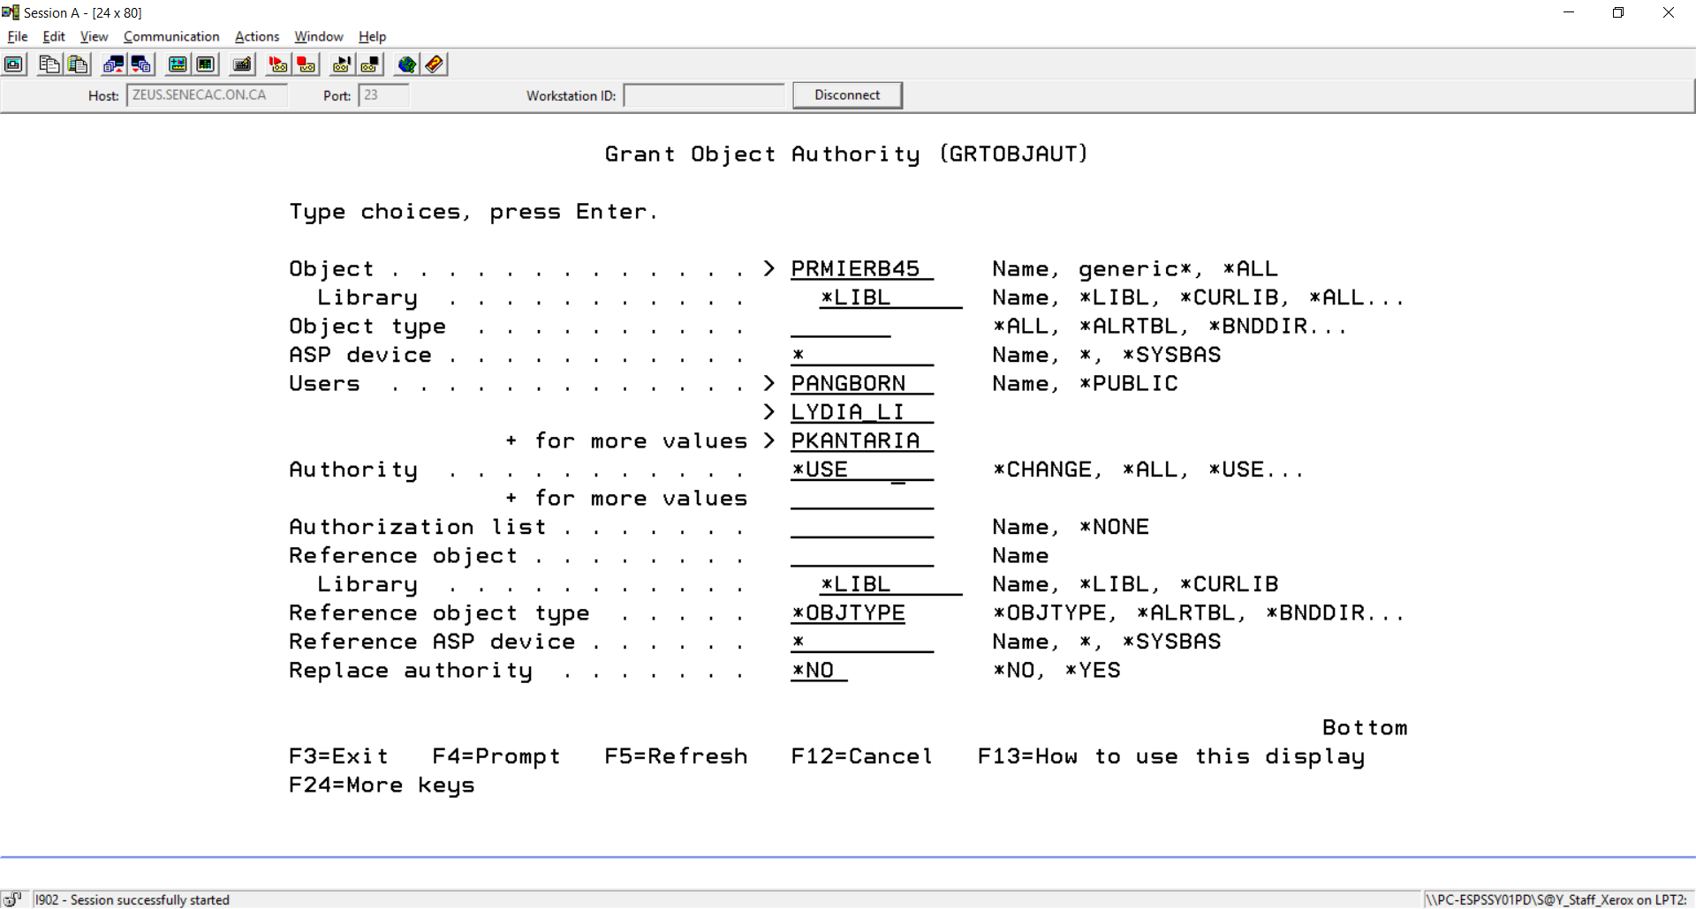
EXITING SQL you can set permissions to the Collection
==> GRTOBJAUT (F4 key)
Instructors are granted access to a Collection
They will also need to be granted access to objects inside the Collection

Slide 6
Collection Object Authorities
When a collection or Schema is created using SQL, the default is to allow *PUBLIC access
This is not how our school work should be done, allowing students to copy someone else's work
A lot of marks will be deducted when an assignment collection is not protected
The *PUBLIC should be set to *EXCLUDE for the Collection
We can run a simple program to see who gets marks deducted
*USE allows Instuctor user profiles to access Collection objects

Slide 7
Creating an INDEX
An INDEX supports the ORDER BY clause in a SELECT statement
CREATE INDEX CUSTLNAME ON PRMIERB45/CUSTOMER (LAST_NAME)
Select * From CUSTLNAME
CUSTLNAME in *LIBL type *FILE not found.
Select * From Customer
Order By Last_Name
This Select works more efficiently with INDEX support

Slide 8
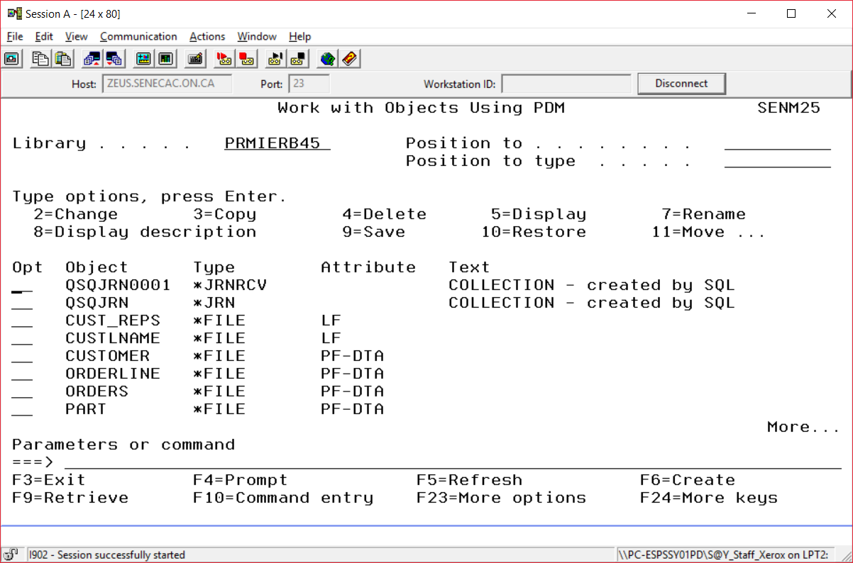
The view (Cust_Reps) and the index (custlname) show as logical files

Slide 9
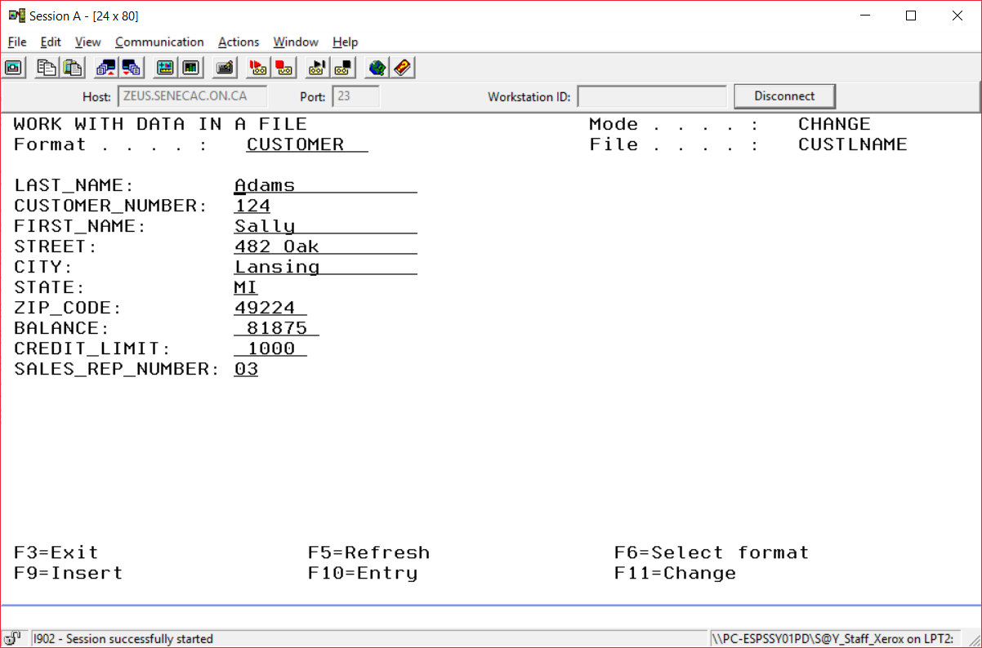
Native programs will process an index
exiting from SQL, the following is run from the command line:
==> UPDDTA PRMIERB45/CUSTLNAME
This starts with the Adams row (record)

Slide 10

When native programs process Customer:
The order reflects the data entry order of the rows
==> UPDDTA PRMIERB45/CUSTOMER
This starts with the Samuals row (record)
Samuals was the first row entered into this table

Slide 11
Data is not duplicated in INDEXES
An Index contains pointers to rows in a Table
The pointers reflect the sort order specified when the INDEX is created
The CUSTOMER table data like City & Balance will not be duplicated in the index
This would lead to modification anomalies
A View also does not duplicate table data
It has pointers to table rows that meet the view criteria

Slide 12
RUNSQLSTM
You can get a series of SQL statements stored as text to execute with the RUNSQLSTM from the command line (not in interactive SQL)
Each statement must end with a semicolon
All statements are executed in order, if an error occurs all the statements are rolled back
An error could be forgetting the semicolon or misspelling with syntax (CRETE instead of CREATE)
The next slides show a member named TESTCONST1 of a source physical file called LAB6 being run

Slide 13
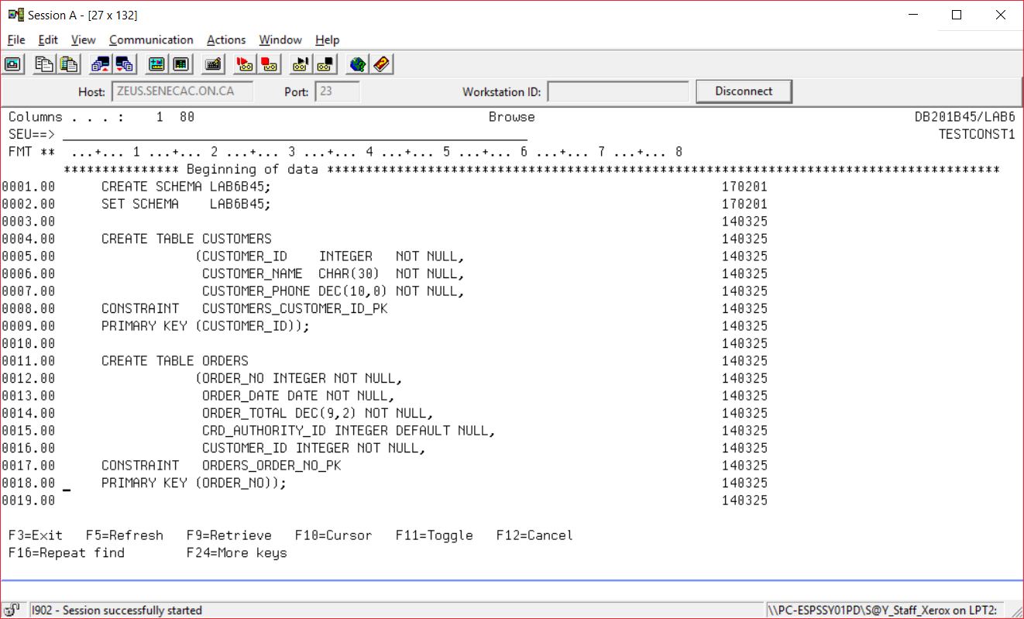

Slide 14
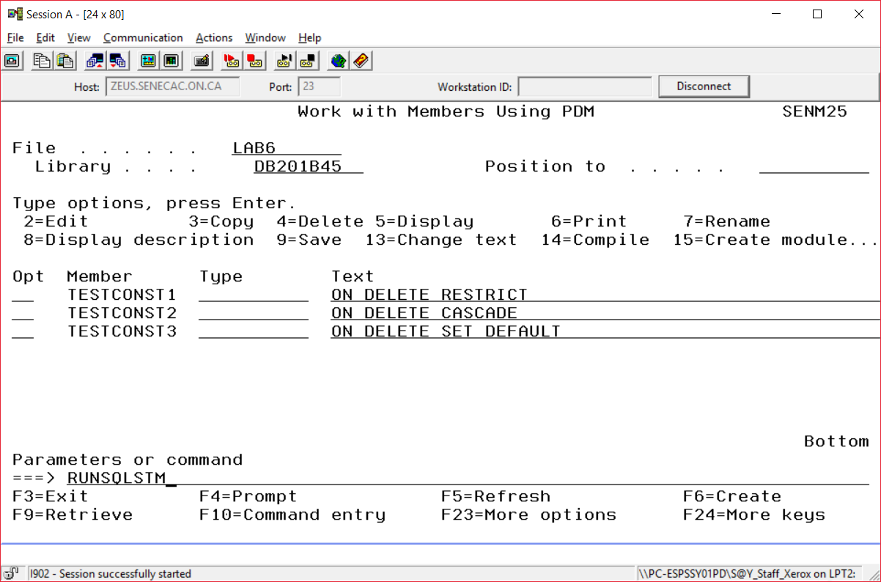

Slide 15
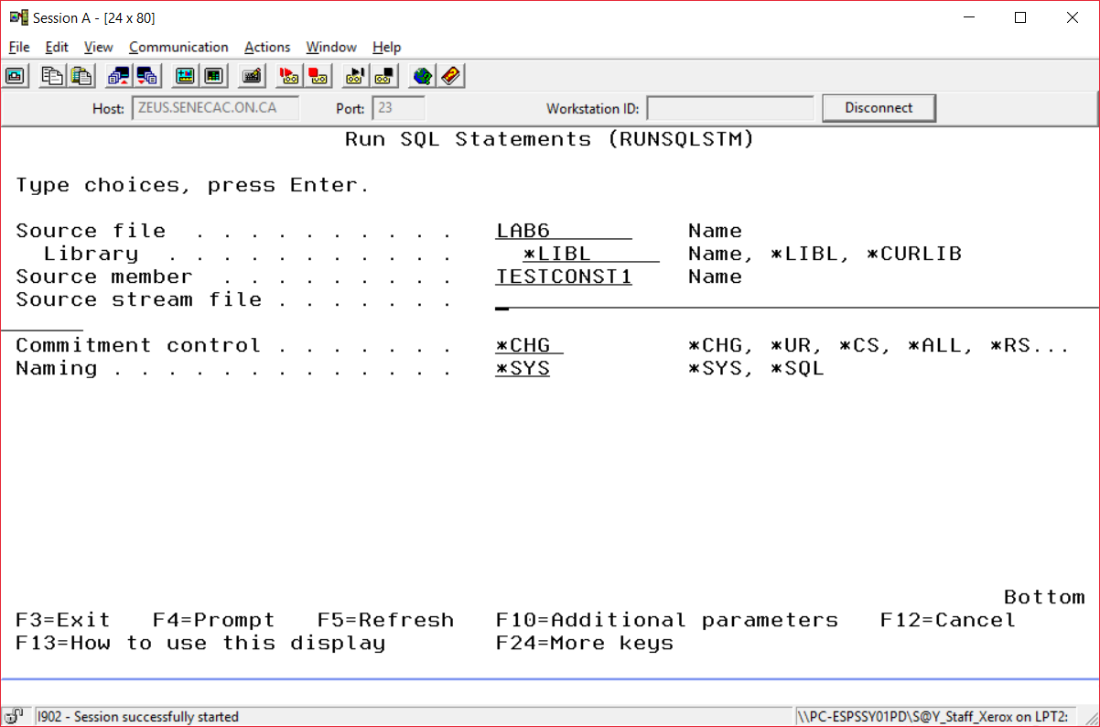

Slide 16
RUNSQLSTM
When the RUNSQLSTM is successfully run you can view both the CUSTOMER and ORDER tables in interactive SQL
SET the schema to the appropriate name
SELECT * FROM CUSTOMERS
SELECT * FROM ORDERS

Slide 17
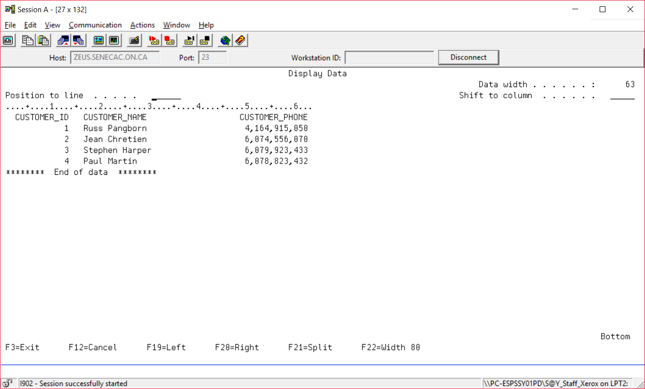

Slide 18
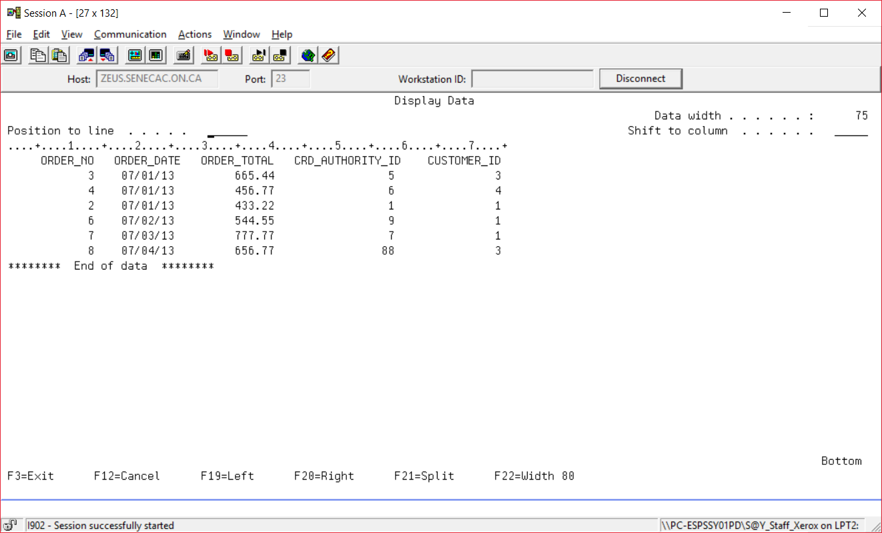

Slide 19
ON DELETE OPTIONS
LAB 6 will examine the results of three options used with referential constraints when a record is deleted from a parent file
ON DELETE RESTRICT (the default)
ON DELETE CASCADE
ON DELETE SET DEFAULT

Slide 20
TESTCONST1
This will be copied from DBS201LIB/LAB6
==> CRTSRCPF LAB6
==>WRKMBRPDM DBS201LIB/LAB6
Option 3 to copy to your LAB6 source file
Collection names must be unique
WRKMBRPDM LAB6 (to edit your copy)
Option 2 allows editing
Change the schema name to LAB6???

Slide 21
Add SQL Statements
Orders must refer to existing customers
For ON DELETE RESTRICT (the default) no extra statement is required
To Load Data into CUSTOMERS and ORDERS get the data from tables in RUSSDBS statements need to be added
?
RUNSQLSTM with your changed TESTCONST1
Test out the deletion of customer number 1

Slide 22
TESTCONST2
After testing, copy TESTCONST1 using option 3
For ON DELETE CASCADE an ALTER TABLE statement needs to be modified
?
RUNSQLSTM with your changed TESTCONST2
Test out the deletion of customer number 1
What is different?

Slide 23
TESTCONST3
After testing, copy TESTCONST3 using option 3
For ON DELETE SET DEFAULT an ALTER TABLE statement needs to be modified
?
You also need an additional row in one of the tables to support the SET DEFAULT option, add a new statement to do this
RUNSQLSTM with your changed TESTCONST3
Test out the deletion of customer number 1
What is different?

